Slide 1
Finance HL
Efficiency ratios
Budgets

Slide 2

This shop keeps 600 candles on their shelf.
Every year, they sell 6000 candles.
How many days does the average candle sit on the shelf?
How many times does their inventory turnover each year?
Notes:
30%. Use this to introduce that margin = profit/sales * 100%.)

Slide 3
600 candles on shelf. 6000 sold each year.
How many days does the average candle sit on the shelf?
365*600/6000=36.5 days.
How many times does their inventory turnover each year?
6000/600=10 times
Notes:
30%. Use this to introduce that margin = profit/sales * 100%.)

Slide 4
Types of efficiency ratios
Stock
How quickly is the stock turning over?
Use measure of the value of the stock held, not the number of things in the inventory.
Use the cost of sales, not the revenue or number of things sold.
Debtor/creditor days
How long does it take on average to pay your debts? (Longer generally better.)
How long does it take on average to get paid what you are owed? (Shorter generally better.
Gearing ratio
The proportion of a business’s capital that has been raised through potentially costly/risky long-term debt.

Slide 5
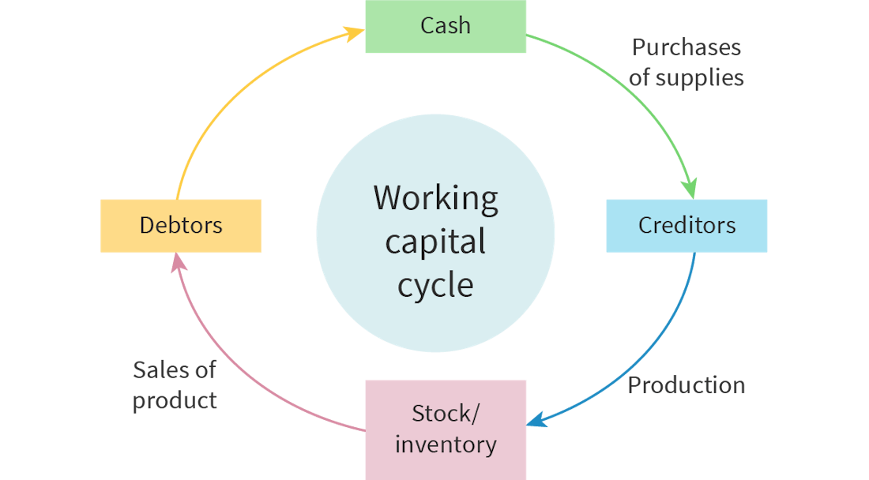
Efficiency ratios: stock
Businesses want to move through the working capital cycle at a reasonable rate.
That is, they want to convert their inventory to cash at a reasonable rate.

Slide 6
‘Reasonable rate’? - stock
Too slow?
Physical costs: Shelf/warehouse space unnecessarily used
Financial costs: finance held up in the value of the inventory: borrowing or opportunity cost.

Slide 7
‘Reasonable rate’? - stock
Too fast?
Unable to meet variable demand → waiting times/missed sales
Not enough for customers to sample

Slide 8
‘Reasonable rate’? - stock
You can compare within similar industries
Do not compare between industries

Slide 9
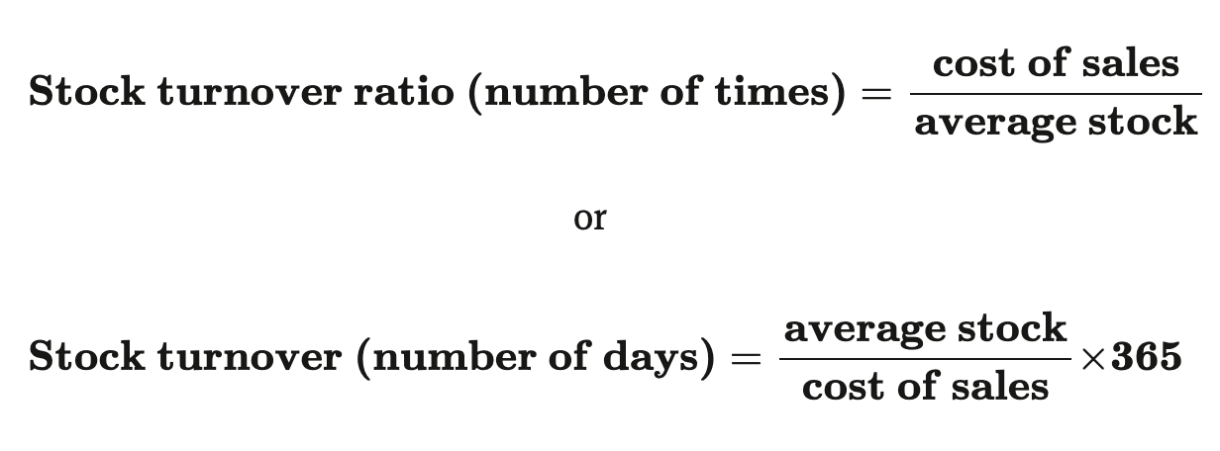
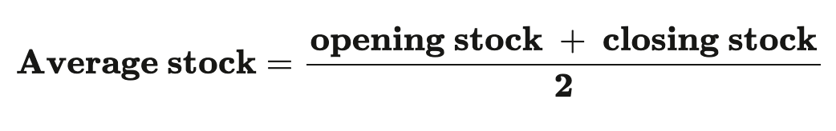

Slide 10
Debtor and creditor days
The debtor days ratio measures the average number of days it takes the business to collect its debts.
Generally, lower is better: there’s an opportunity cost of someone else holding the money & and can hurt cash flow.
But allowing others to buy on credit may increase sales; being too ‘impatient’ may reduce sales.
The creditor days ratio is an indicator of the average number of days it takes a business to pay its debts.
Generally, higher is better.
But increasing it too much can lead to poor relations with your suppliers.

Slide 11
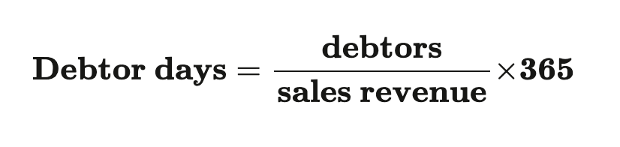
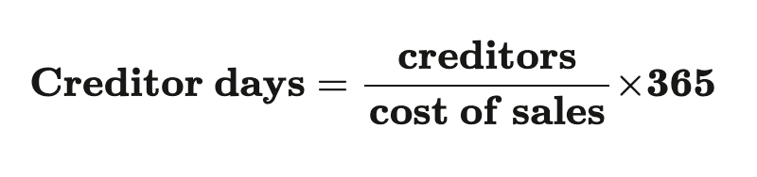

Slide 12
Gearing ratio
The gearing ratio measures how much of the business’s capital employed is financed by long-term debt, such as non-current liabilities.
The higher the gearing ratio, the more of the business’s operations are funded by long-term debt.
This is risky and may not be positive for the business because, if interest rates increase, then loan payments could rise and undermine profits and dividends to shareholders.

Slide 13
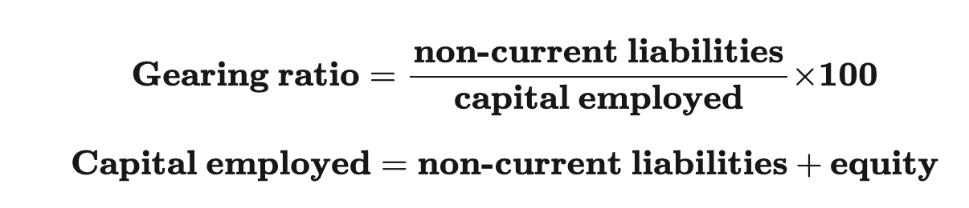

Slide 14
Financial Information for the year ended 31 December 2024 | ($)
Sales revenue | 240,000
Cost of goods sold (COGS) | 120,000
Opening stock | 15,000
Closing stock | 25,000
Debtors (accounts receivable) | 30,000
Creditors (accounts payable) | 20,000
Long-term loans | 50,000
Share capital | 80,000
Retained profit | 30,000
Total capital employed | 160,000
Calculate:
Stock turn over
Times
Days
Debtor days
Creditor days
Gearing ratio
Notes:
Average stock = (15,000 + 25,000) ÷ 2 = 20,000
Stock turnover = 120,000 ÷ 20,000 = 6 times per year
Stock turnover (days) = (20,000 ÷ 120,000) × 365 ≈ 61 days
Debtor days = (30,000 ÷ 240,000) × 365 ≈ 46 days
Creditor days = (20,000 ÷ 120,000) × 365 ≈ 61 days
Gearing ratio = (50,000 ÷ 160,000) × 100 = 31.25%

Slide 15
Net present value
HL Only

Slide 16
Would you rather have 1,000,000 VND today or 5,000,000 VND in 2027 year?
Would you rather have a Honda Airblade as soon as you can get a license, a Honda Accord when you're 25 or a BMW when you're 35?
Would you rather get unlimited cold brew with vanilla foam for one month now, or for one year starting in 2030?

Slide 17


Slide 18


Slide 19


Slide 20
Money now is worth more than in the future because…
we have a psychological bias toward the present
we can invest a small amount now create a bigger amount in the future
generally, there is inflation, i.e. prices go up; money buys less in the future = money is worth less in the future = money devalues.
Maybe Fry’s billions aren’t as good as they sound.

Slide 21
Some working out…
Imagine you have 1,000,000 today and you can get 4% a year.
How much will you have in:
1 year?
2 years?
10 years?
50 years? (you retire!)
1: 1,000,000 x 1.04 = 1,040,000
2: 1,000,000 x 1.04 x 1.04
= 1,000,000 x 1.04² = 1,081,600
50: 1,000,000 x 1.04⁵⁰ = 7,106,683
n: 1,000,000 x 1.04^{n}

Slide 22

A scary thought…
“It’s only 100,000 VND.” But you could invest that with a return averaging 8%!
100,000 x 1.08⁵⁰=
4,690,161 VND when you retire!

Slide 23
Going backwards: What’s 1,000,000 VND next year worth now, assuming 4% return?
That is, how much would you need to have now to get a million next year?
?
x1.04
1,000,000 VND
÷1.04

Slide 24
Going backwards: What’s 1,000,000 VND in 10 years worth now, assuming 4% return?
?
x1.04¹⁰
1,000,000 VND
÷1.04¹⁰

Slide 25
Going forwards: If there is inflation of 5% for the next year, how much, in today’s VND, will today’s 1,000,000 VND buy?
x0.95
?
1,000,000 VND
÷0.09

Slide 26
Going forwards: If there is inflation of 5% for the next 6 years, how much, in today’s VND, will today’s 1,000,000 VND buy in 2031?
x0.95⁶
?
1,000,000 VND
÷0.09⁶

Slide 27
Year | Cash inflow ($) | Cash outflow ($) | Net cash flow ($) | 10% discount rate | Present value ($)
1 | 80 000 | 20 000 | 60 000 | 0.9091 | 54 546
2 | 140 000 | 60 000 | 80 000 | 0.8264 | 66 112
3 | 240 000 | 120 000 | 120 000 | 0.7513 | 90 156
4 | 360 000 | 200 000 | 160 000 | 0.6830 | 109 2
1/((1+% discount rate)^year)
Initial investment: $200 000.

Slide 28
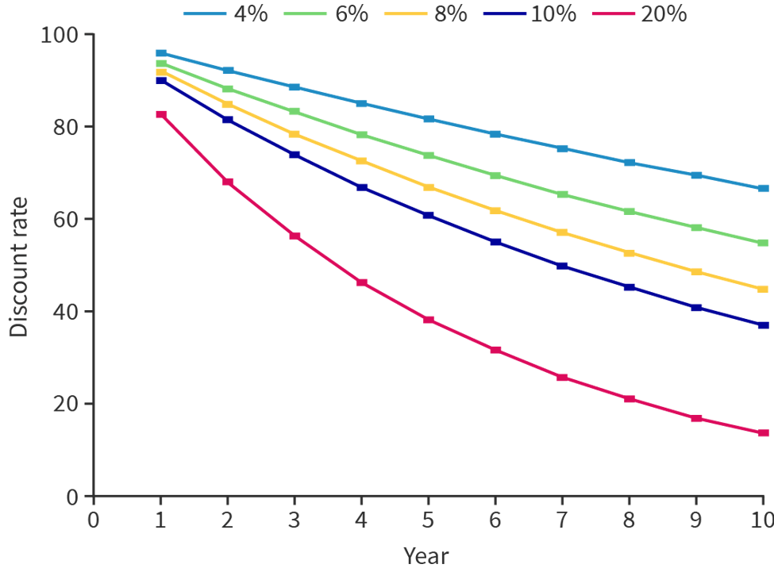
Choosing your discount rate matters and it’s hard
Cost of capital: Minimum return needed to cover borrowing and equity costs.
Project risk: Riskier projects require higher expected returns.
Opportunity cost: Returns available from the next-best investment.
Central bank interest rates: Higher policy rates raise financing costs.
Inflation: Higher inflation reduces future value, pushing rates up.
Economic uncertainty: Instability increases risk premiums.
Industry conditions: Fast-changing or volatile sectors use higher rates.

Slide 29
Practice and evaluation
In NPV playing, play with the various rates to consider:
What happens to your project when you change the discount rate?
How does shifting cash inflows earlier or later affect the outcome? (You might copy the spreadsheet and write in different values rather than rely on the formula.)
How do rising or falling costs change the overall decision?
Which variable in the model seems to matter the most, and why?
Can you make the NPV positive and the ARR negative or vice versa? What does this mean?
Further consideration:
What is the discount rate after 20 years at certain percentages? 50 years? 100 years? What are the implications of this?
IB1 BM finance NPV exercises
Practice!

Slide 30
IB1 BM finance AI Investment: a bold or crazy move

Slide 31
Budgets

Slide 32
Cost and profit centres
Cost Centres:
An area of business generating costs but no revenue.
Must predict and manage operational costs.
Relies on revenue allocation from other parts of the business.
Example: School academic departments (Science, History), Head Office, HR, Market Research teams.
Profit Centres:
An area of business generating both revenue and costs.
Aims to generate profit for company: revenues > costs.
So, have own St of P&L.
Example: Individual supermarket branches (Carrefour), school canteen, school shop.

Slide 33
Organising centres - more when we get to HR
By Function:
Specific functional departments treated as cost centres.
Example: Marketing, Finance, Human Resources, IT, Legal.
By Product:
Organized by distinct goods/service categories.
Each product line responsible for its own costs/revenues.
Example: Adidas (Sportswear division vs. Equipment division).
By Geography:
Organized by location or branch.
Standard for multinational corporations (MNCs).
Example: Samsung or Apple regional divisions (North America vs. Asia).

Slide 34
Why bother with budgeting for centres?
Financial
Isolates specific unit performance (profit vs. inefficiency).
Benchmarks efficiency across departments - can compare.
Improves accuracy of whole-business budgeting.
Motivational
Delegates financial authority, boosting autonomy.
Links incentives/rewards to budget targets.
Organisational
Identifies units requiring investment or intervention.
Supports decentralization with centralized monitoring

Slide 35
‘Budgets’?
Scope: Can be set for departments, factories, projects, or individuals.
Key Characteristics:
Short-term: Typically set for 12 months (financial year) or project duration.
Coordinated: Departmental budgets set after corporate objectives; feed into centralized master budget.
Definition: Financial plan for a defined future period forecasting revenues and costs.
Purpose:
Planning financial resources to achieve objectives.
Control, coordination, and monitoring of expenditure.

Slide 36
What did you decide what to dress yourself from your knees down today?

Slide 37
Setting a budget
These can affect changes, or values in budget:
Marketing: Decisions on product, price, or promotion directly impact revenue/cost forecasts.
HR:: Labour turnover rates affect recruitment, training, and salary budgets.
Operations: Changes in efficiency, waste levels, or production methods.
Managerial Attitude: Requires forward-looking, flexible, and realistic mindset.
Analysis of external factors, e.g. with STEEPLE.
Two key methods of determining a budget level:
Historical: Based on previous year’s allocation with incremental adjustments.
Zero-based: Departments start from zero; must bid for and justify all expenditure.

Slide 38
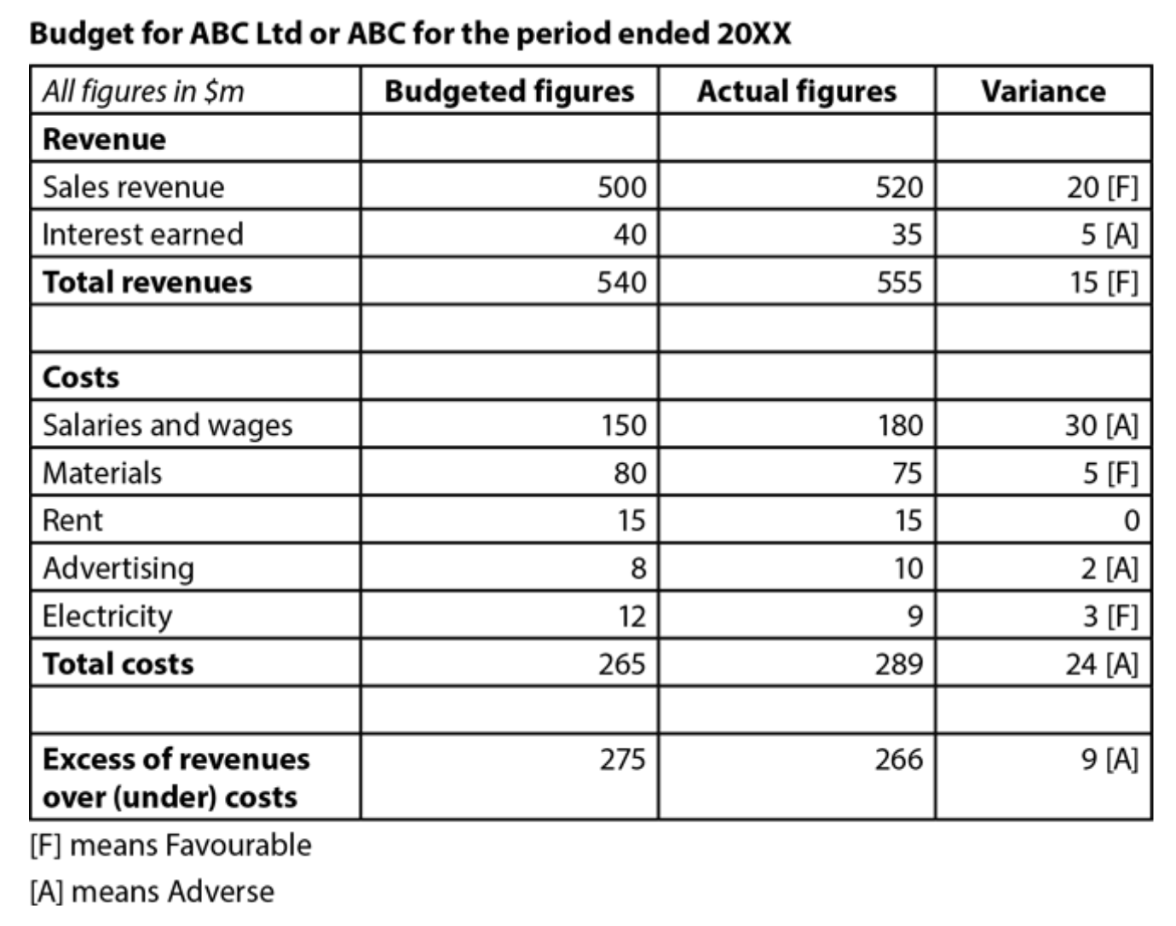

Slide 39
Practice!
3.9.3 on Kognity:
Practice and case study.

